Slide 1
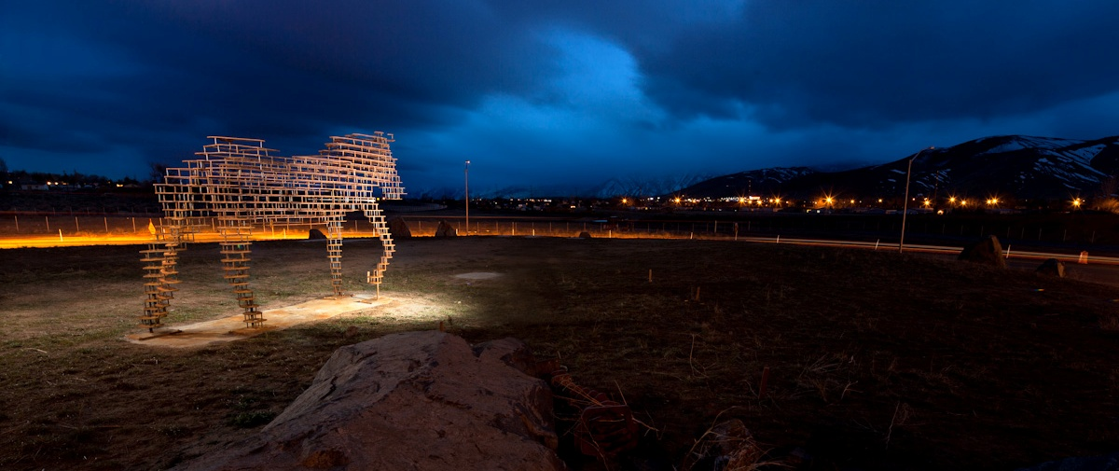
NDOT LANDSCAPE AND AESTHETICS Sustainable Practices at Work
Lucy Joyce, ASLA, RLA #597
Nevada Transportation Conference
April 9-10, 2013
Notes:
4/8/2013
1

Slide 2
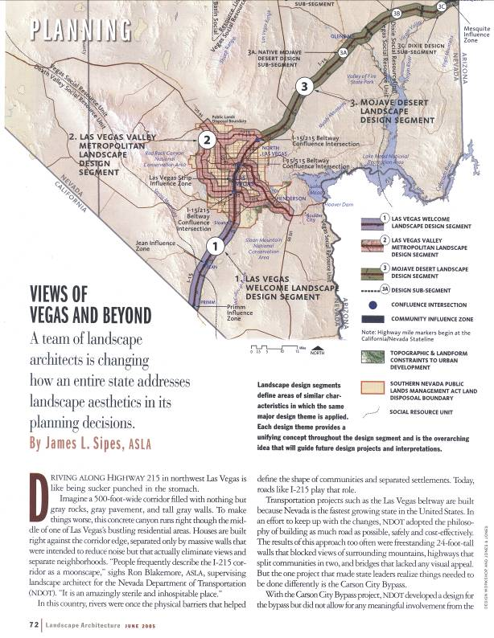
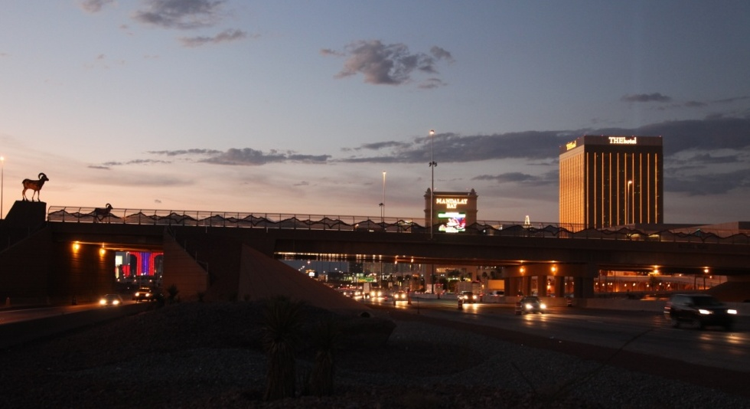
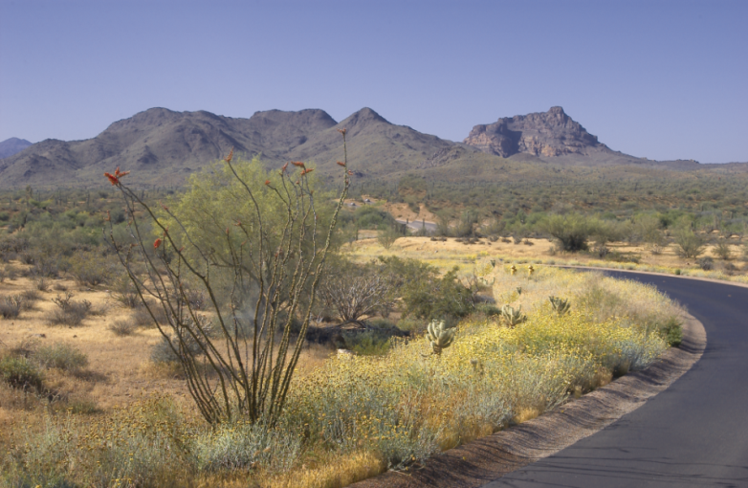
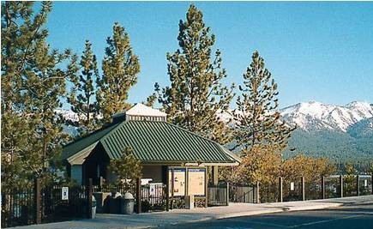
Landscape and Aesthetics involves the total visual impression of the highway, encompassing landform, structures, plants, colors, textures and art.
We envision a system of state highways that reflect the land and people of Nevada.
We believe that Nevada should have highways that are aesthetically pleasing, as well as safe, cost effective and sustainable.
Landscape Architecture Magazine
Notes:
4/8/2013
2

Slide 3
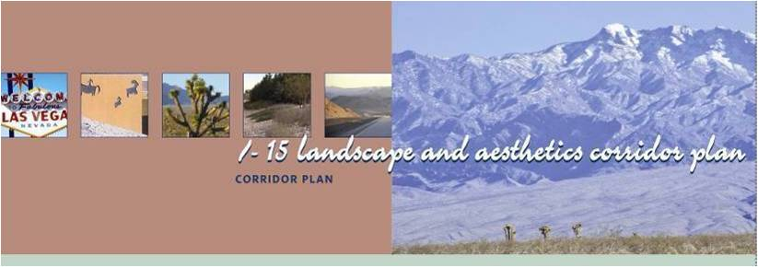
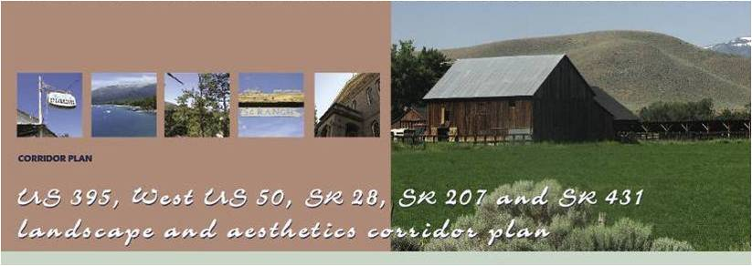
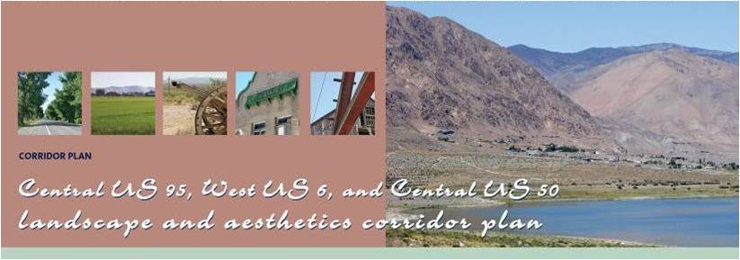
Statewide Policies
Landscape and Aesthetics Policy
… landscape and aesthetics will be considered along with all other design factors in all transportation projects throughout their life cycles.
Policy on Partnerships
…principles of context-sensitive design guide the development of transportation projects.
Policy for the NDOT Landscape and Aesthetics Program
…emphasize regionally appropriate materials and drought-resistant plants.
Policy on Funding
… develop cooperative agreements for funding the design, construction, and maintenance of landscape and aesthetic improvements.
Notes:
4/8/2013
3

Slide 4
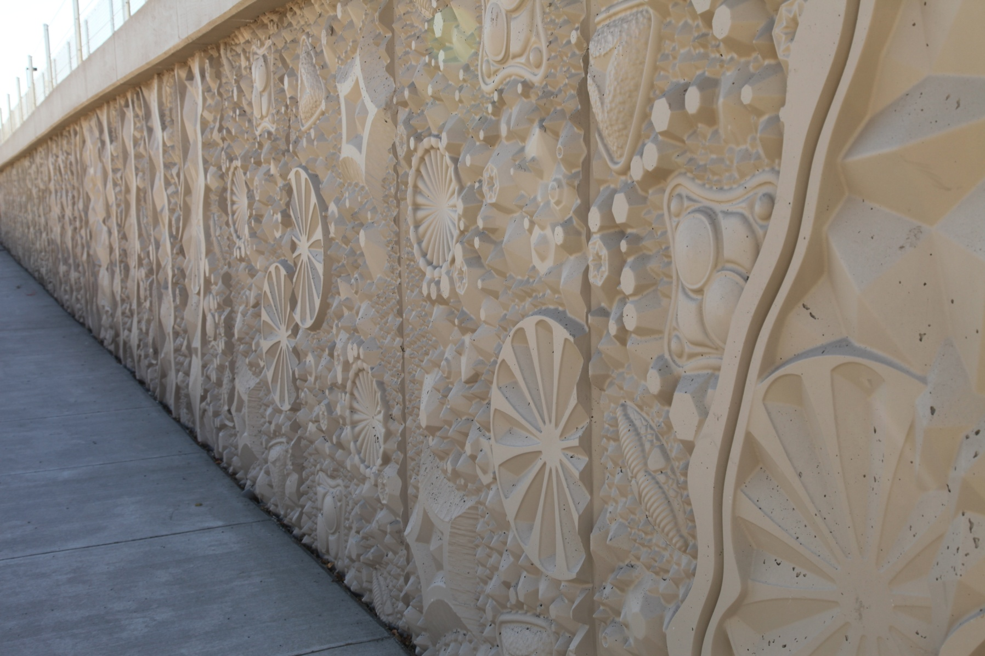
Commitment
Ensures a successful landscape and aesthetics program.
NEW CONSTRUCTION & CAPACITY IMPROVEMENTS
Costs of landscape and aesthetic treatments included in the budget when a highway is first constructed or expanded.
MAINTENANCE
Costs of long-term activities to protect the public's investment in landscape and aesthetic treatments such as pruning, replacing plants, painting, and irrigating.
In Addition
Standard practices of revegetation, slope rounding, contouring and earth forming, paint or integral color on bridges and barrier rails means landscape and aesthetics are included even on non-capacity projects.
Notes:
4/8/2013
4

Slide 5
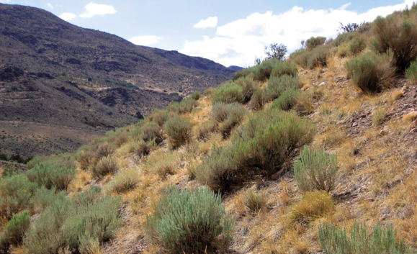
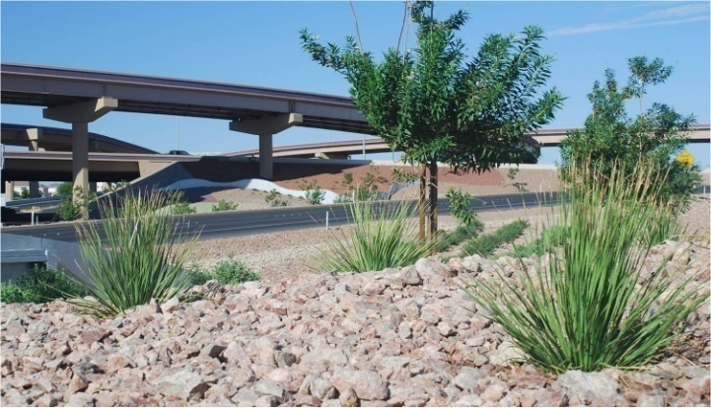
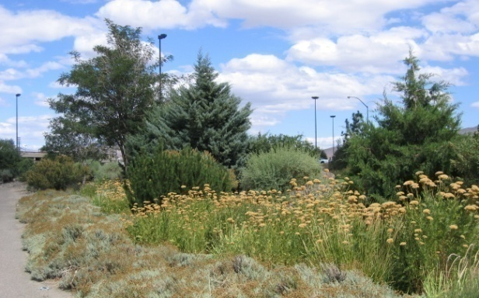
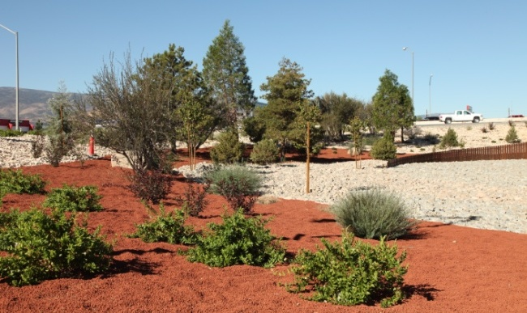
Softscape Treatment Types
Levels of Landscape Treatment
Low maintenance to high maintenance
Native Revegetation
Enhanced Native
Regionally Adapted
Regional Ornamental
Notes:
4/8/2013
5

Slide 6
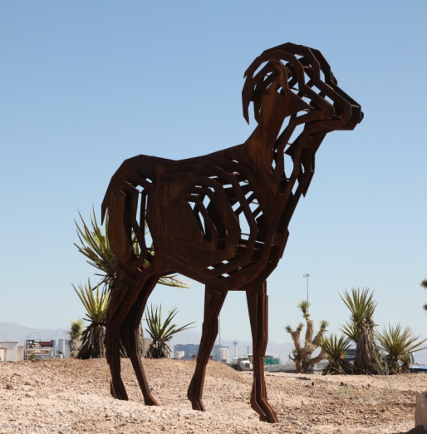
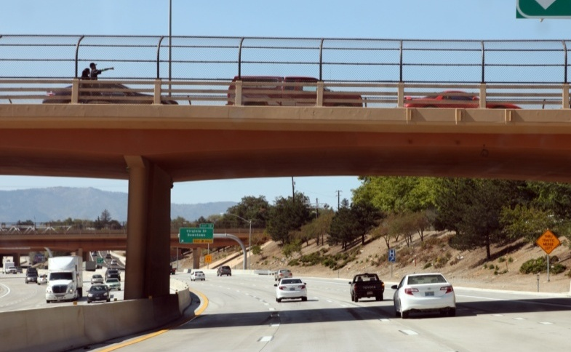
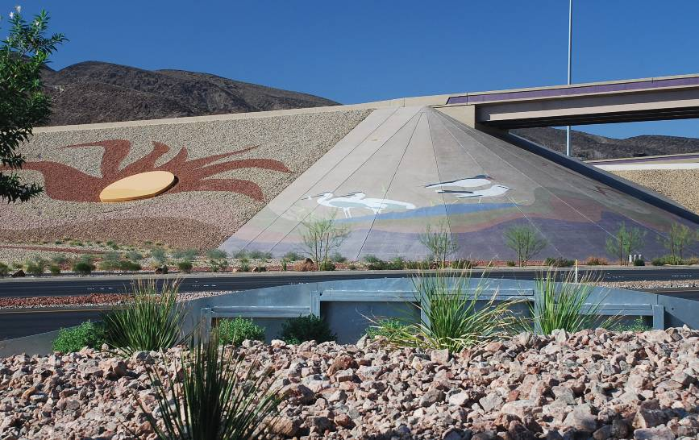
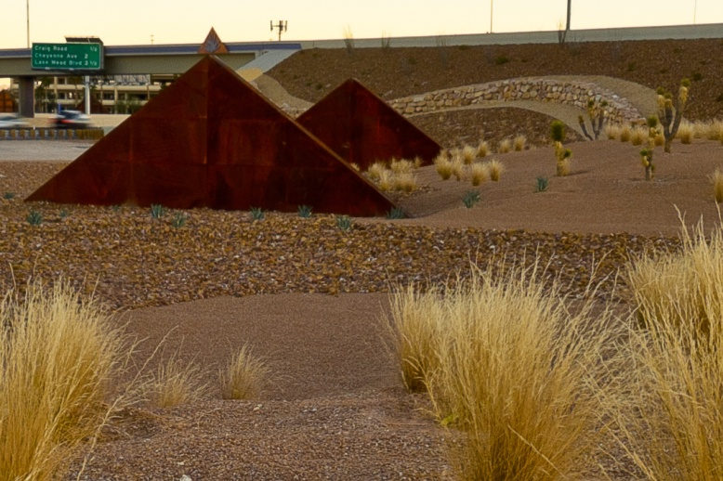
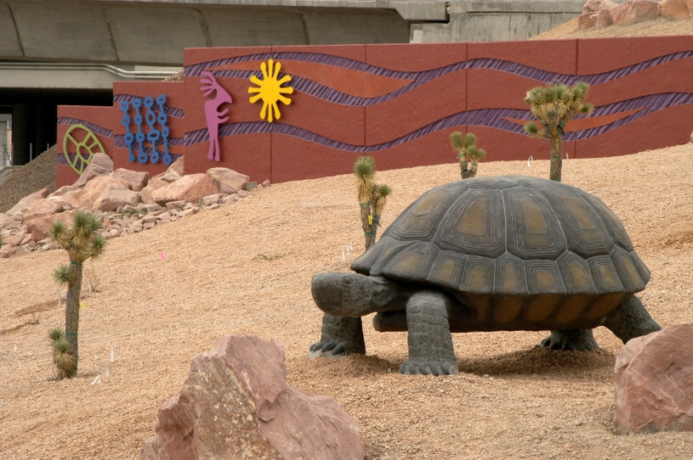
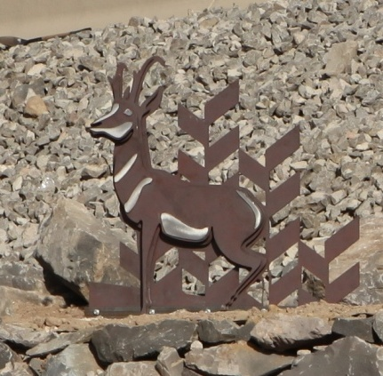
Hardscape Treatment Types
Levels of Landscape Treatment
Simple to elaborate
Standard
Accentuated
Focal
Landmark
Notes:
4/8/2013
6

Slide 7
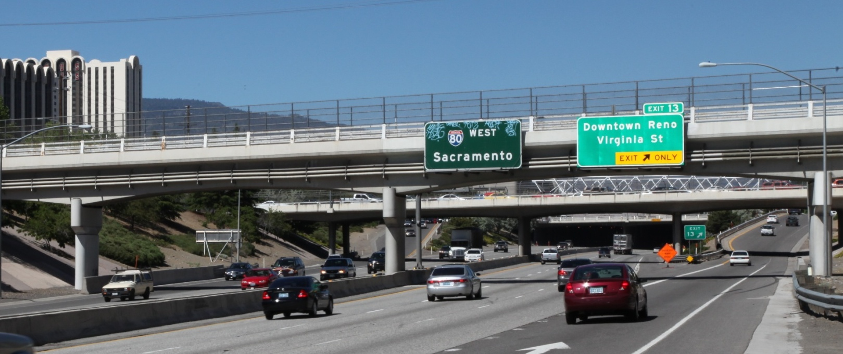
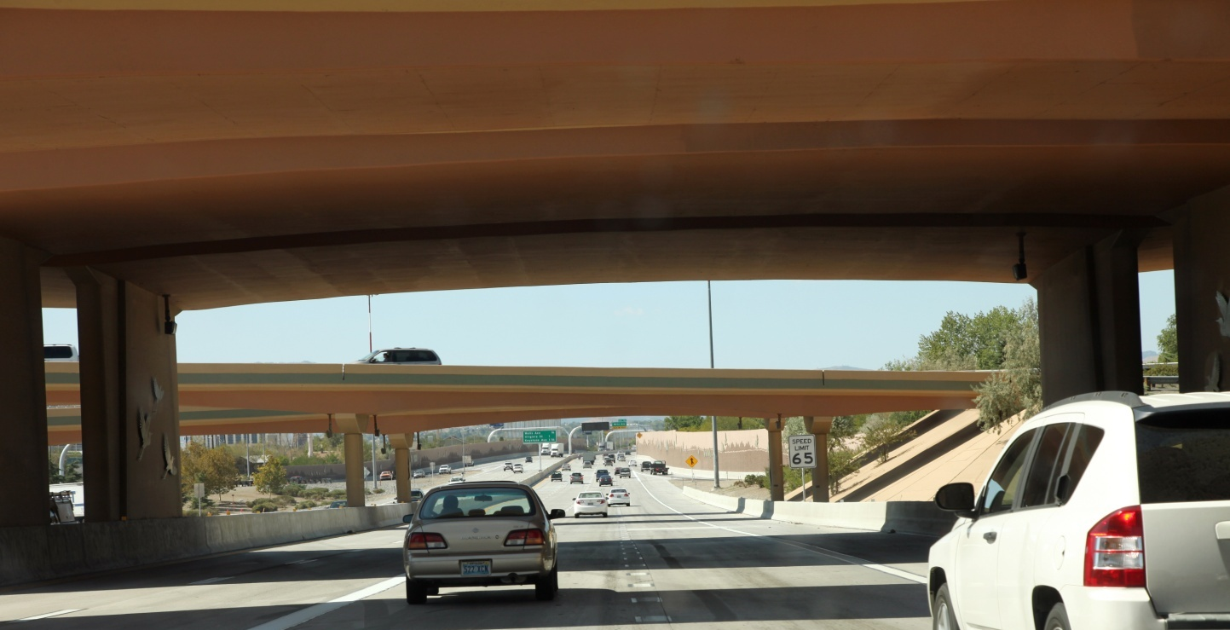
Color Palette
A low cost and effective paint treatment creates high impact!

Slide 8
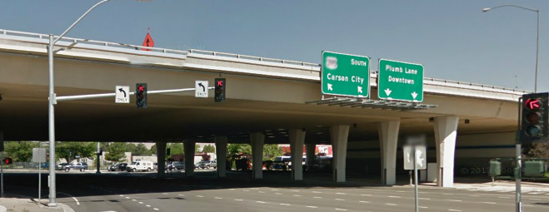
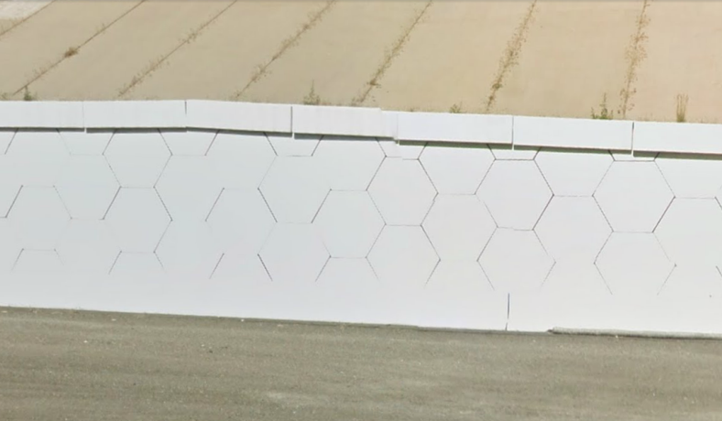
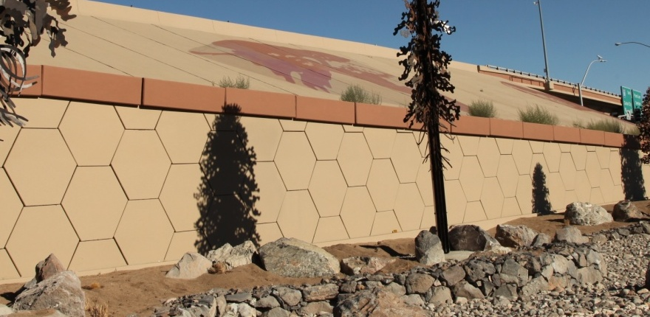
And with a few painted details an even greater impact!

Slide 9
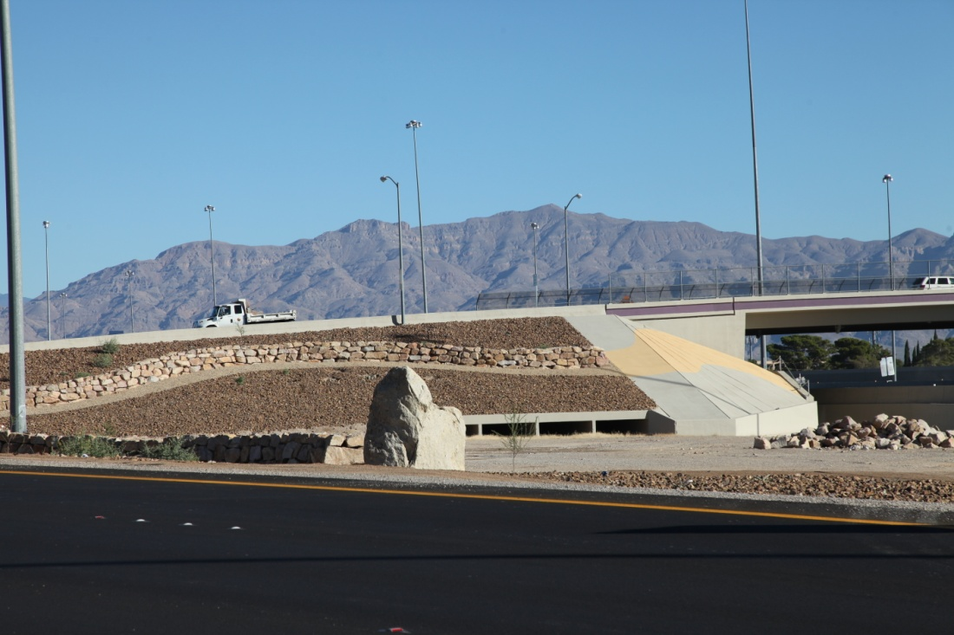
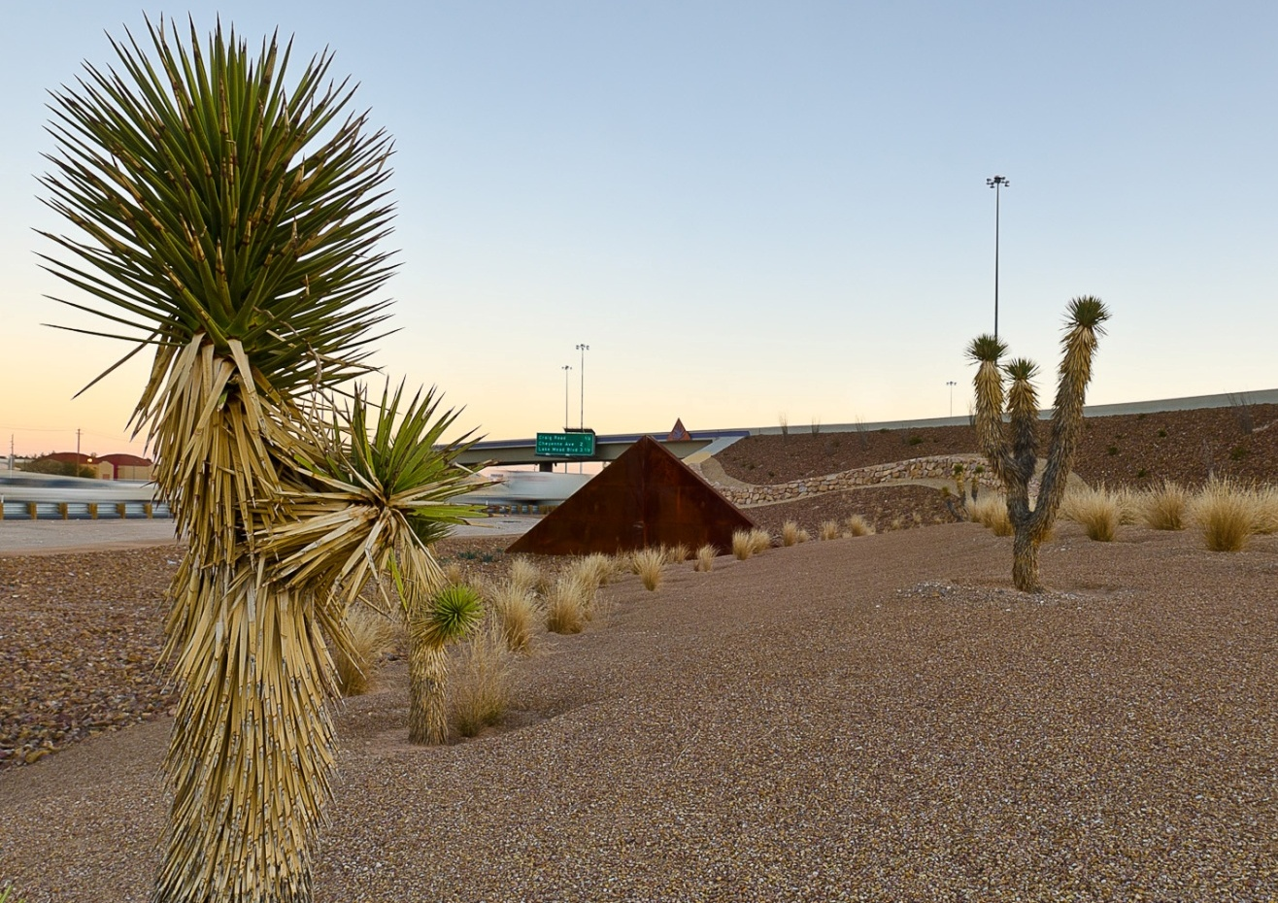
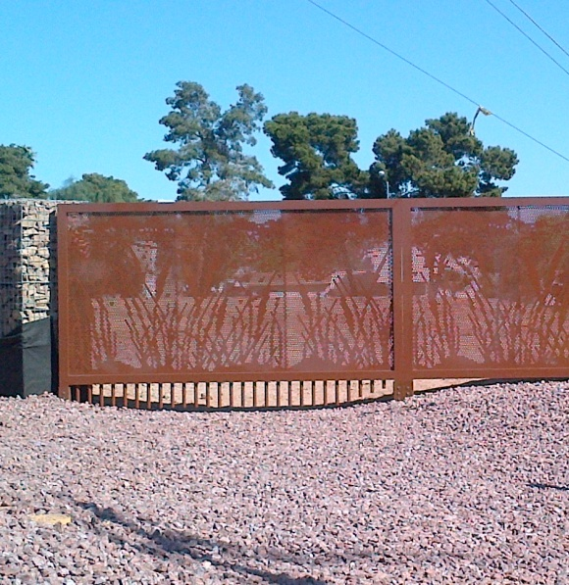
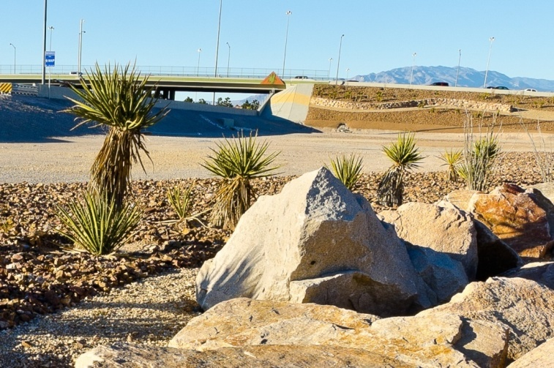
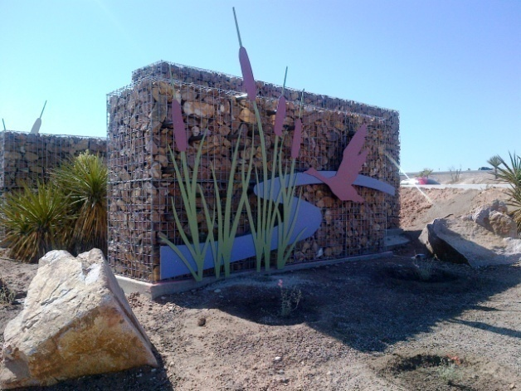
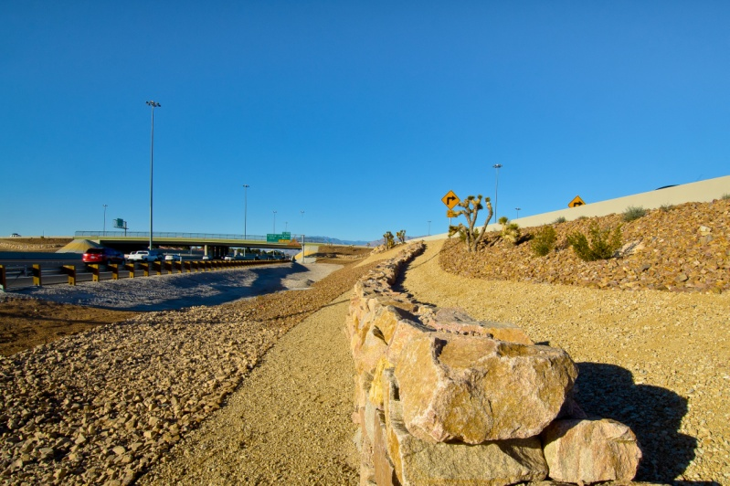
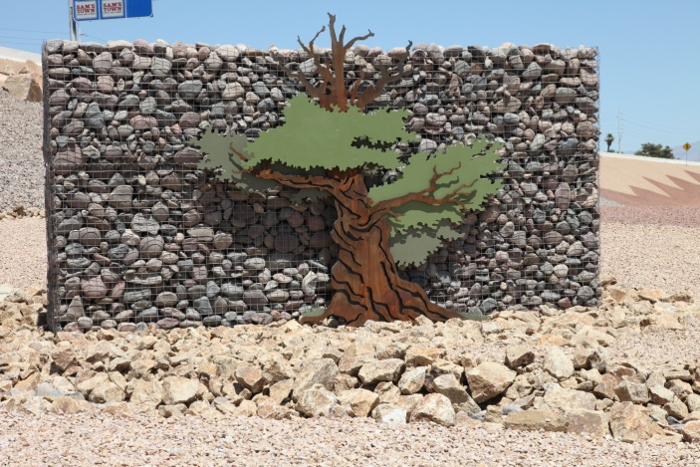
US 95 & I 515
Las Vegas

Slide 10
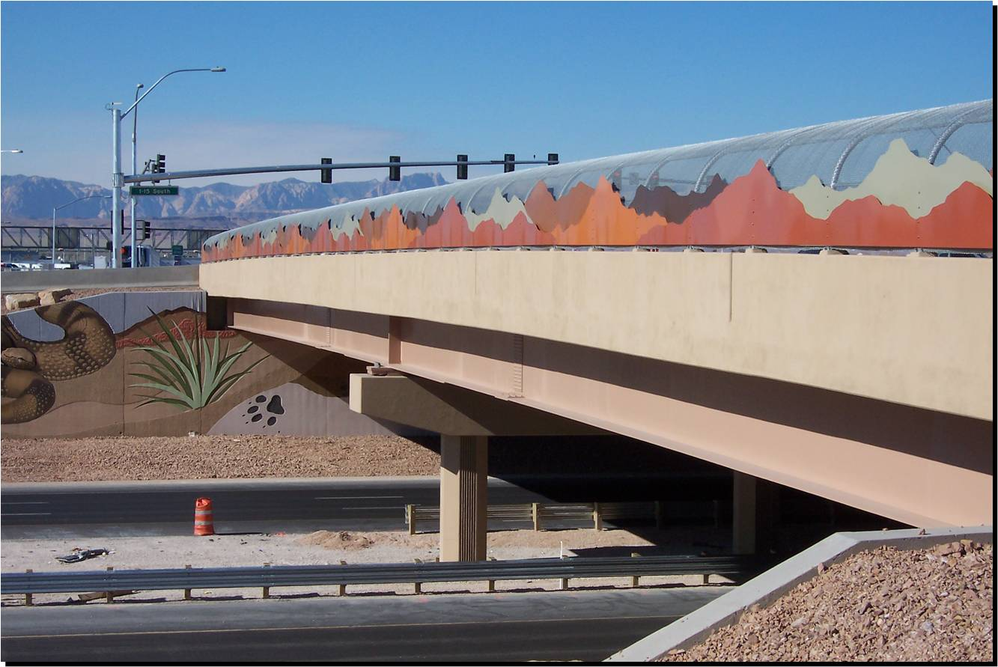
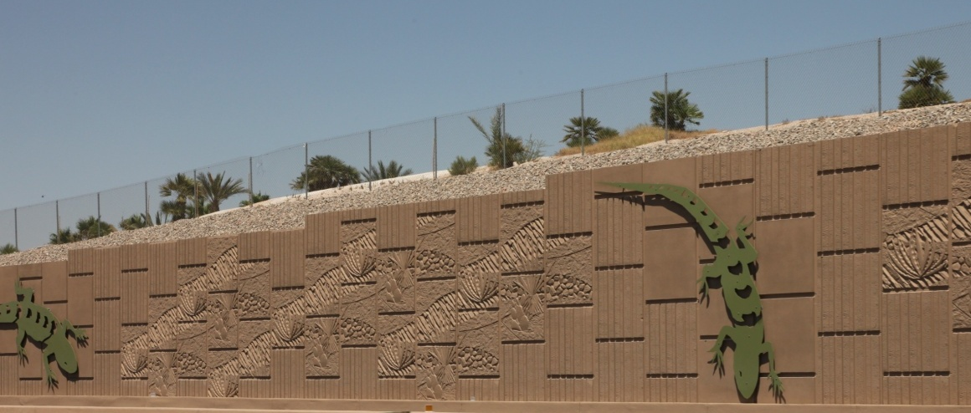
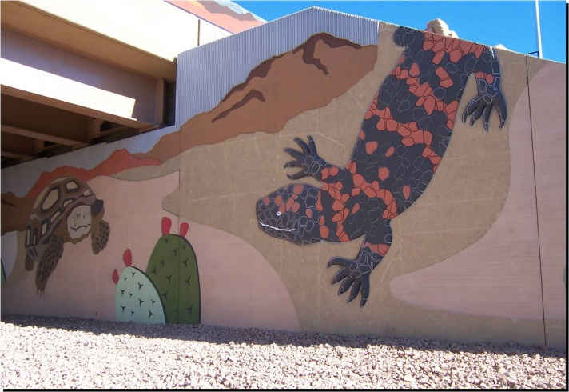
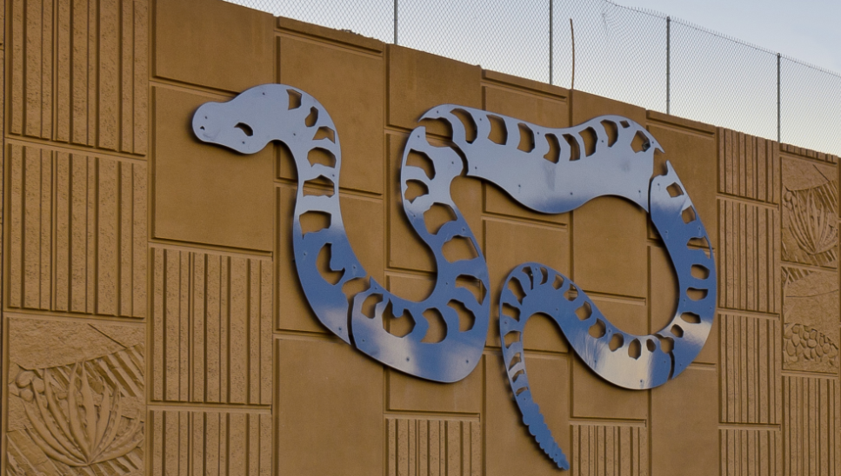
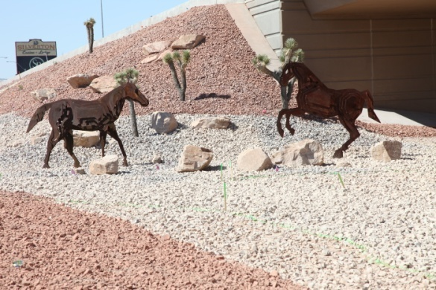
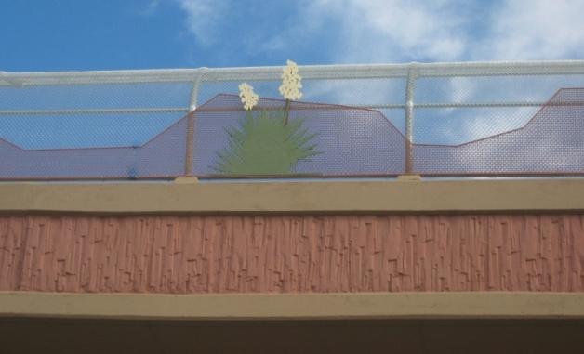
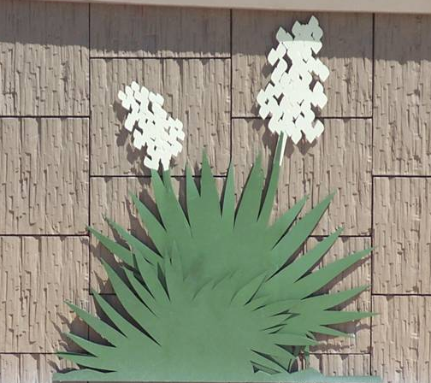
I 15 Las Vegas

Slide 11
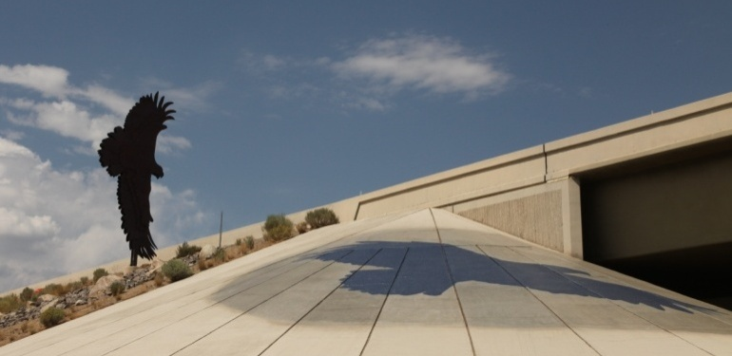
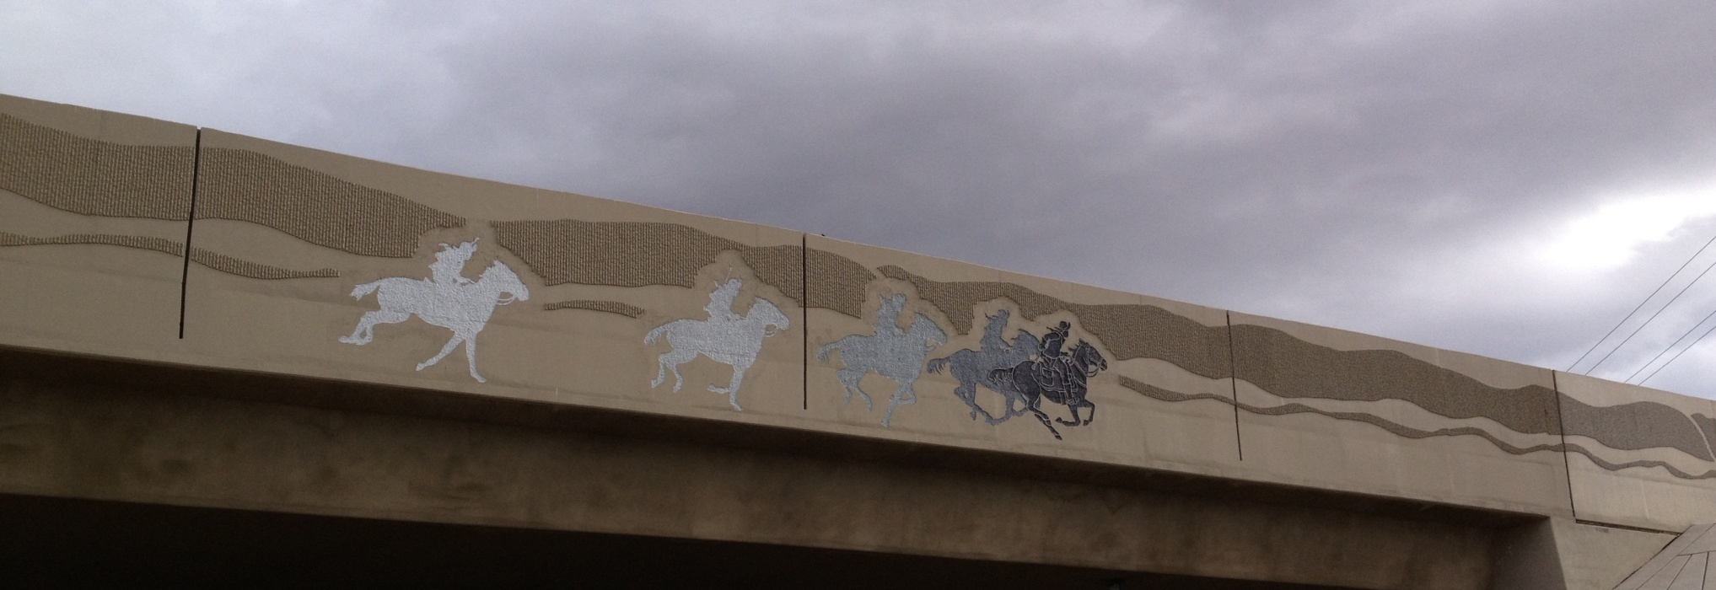
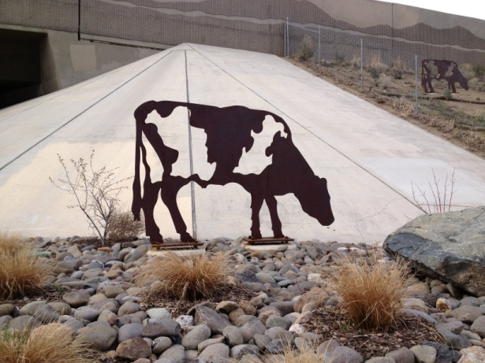
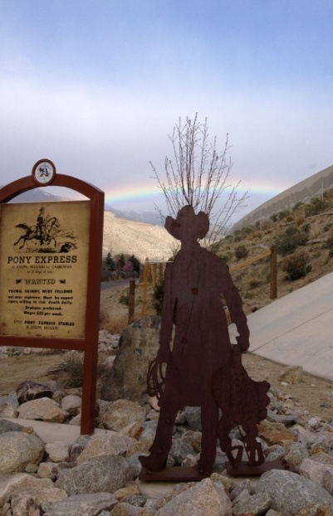
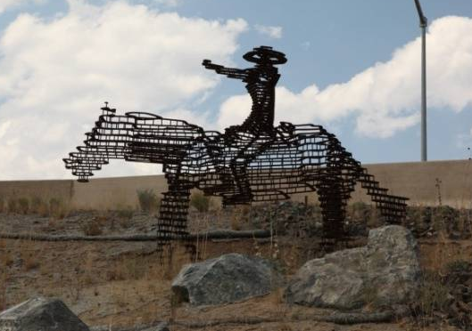
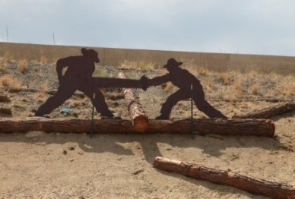
I 580 Carson City

Slide 12
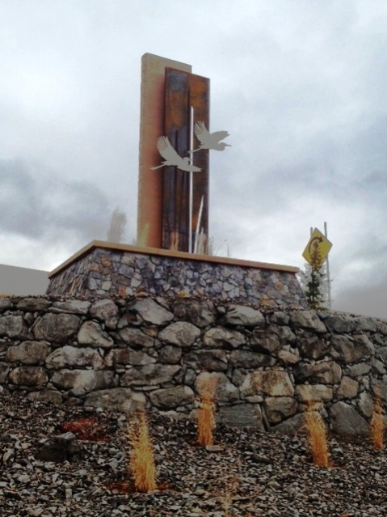
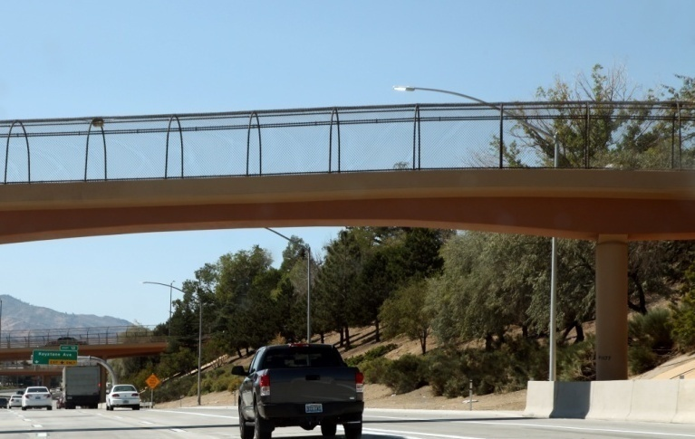
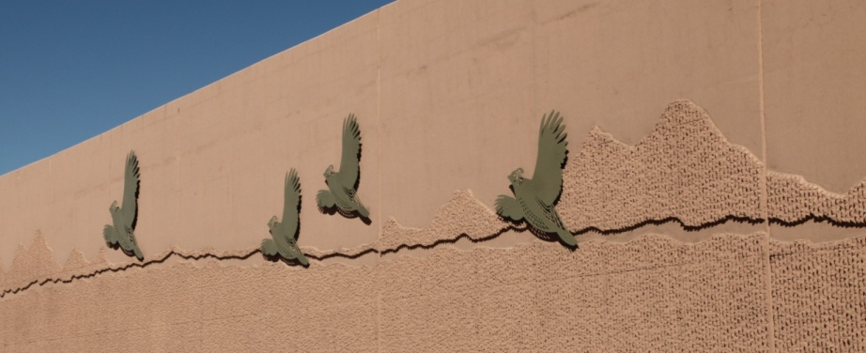
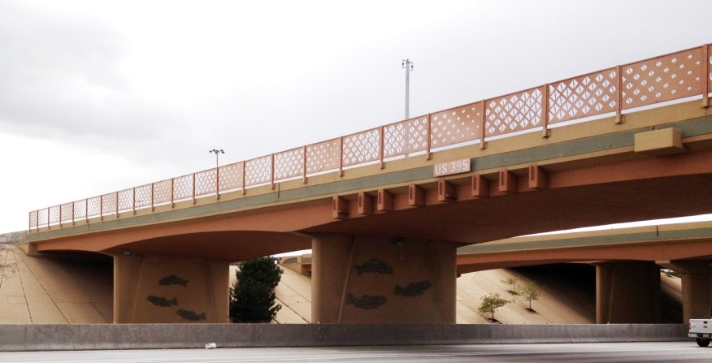
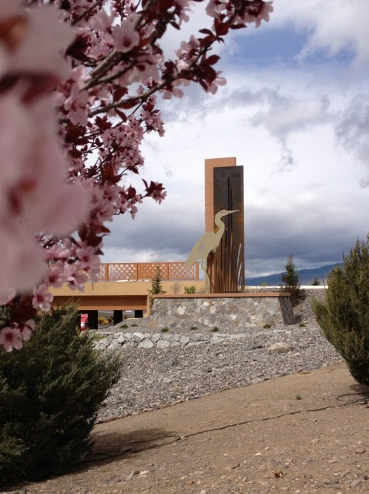
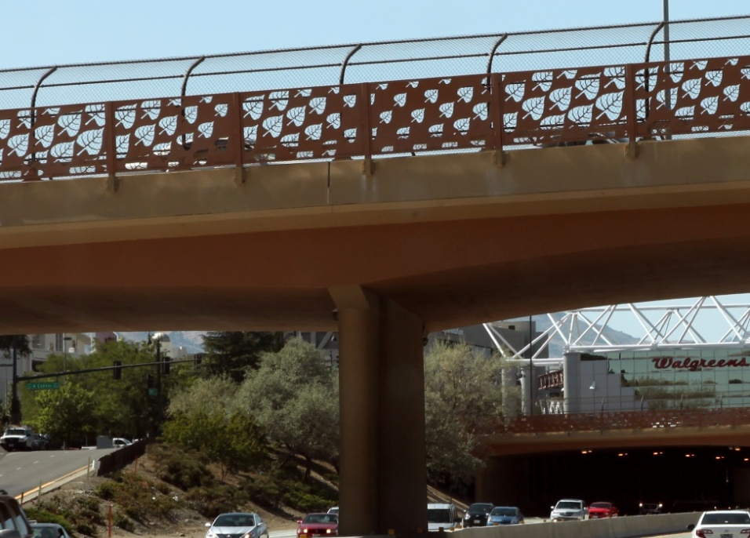
I 80 Reno

Slide 13
I 580 Reno

Slide 14
Rural Nevada
Schellbourne
Searchlight
Carlin
Wildlife Crossing

Slide 15
SUSTAINABLE APPLICATIONS: Native Seed Mixes
Require less water to germinate and
thrive in Nevada’s climates with little
maintenance.
Cactus salvage and replanting
Salvaging native cacti, not only protects endangered cactus species, but means those plants are available for replanting once work is complete. A partnership has been formed with the Nevada Division of Forestry to maintain the plants between salvage and replanting.
Soil Amendments
The use of soil amendments helps with water retention at the plant’s roots meaning less irrigation is necessary. Amendments also supply nutrients making for more successful plantings with less fertilizers.

Slide 16
Native Plants
no irrigation

Slide 17
Cactus Salvage
Boulder City Bypass

Slide 18
SUSTAINABLE APPLICATIONS: Water Harvesting:
Reduces stormwater runoff volume
from paved surfaces, reduces peak
discharge rates, increases recharge
through infiltration, and reduces
pollutant transport through direct infiltration.
A 6,000-square-foot paved site in Northern Nevada
produces more than 32,660 gallons of annual runoff.
Local Materials:
Require less energy to transport than those
brought in from long distances and better suit
the projects aesthetically.
Water harvesting basins, Meadowood Mall Way, Reno.

Slide 19
Sustainability
Three Pillars of Sustainability
Economic Prosperity Completion of an NDOT Landscape and Aesthetics project can involve as many as 20 different professional disciplines in fields ranging from biology to welding.
Environmental Protection Practices include using drought tolerant vegetation, water harvesting, erosion control, revegetation including cactus salvage and replanting and protection and creation of wildlife habitat.
Social Justice Projects help communities maintain a sense of pride, improve property values, attract business and reduce graffiti.
Notes:
4/8/2013
19

Slide 20
Acknowledgements
“Another part of all these projects might be a bit more subtle but also is important. That’s the effort -- and money -- that NDOT and other agencies have committed to public art to go along with the road improvements. It’s a recognition that road building doesn’t have to create a blight on the landscape but can instead beautify the community visually, too.
They’ve succeeded.”
RGJ editorial
November 29, 2012
“When you see public art instead of a bunch of weeds, it shows we’re trying to present ourselves in a certain way, that we take your business seriously and we take this community seriously. Public art elevates and challenges people. It soothes and encourages.”
Reno artist Paolo Cividino
October 14, 2012, RGJ Reno Rebirth

Slide 21
“It is so lovely to see the painted concrete decorations, the magnificent statuary and the beauty created with just rock and gravel. Thank you so much for cleaning up the trash and weeds and making our roads something to be proud of and appreciated. It shows we care about our city and how we appear to ourselves and others.”
Public Approval
“…how pleased we are with the facelifts and improvements you have given the freeways. ”
“The overpasses and wall artwork and standards/monuments are so appealing. … you have found a way to make the byways attractive and reflect the spirit of the West.”
“We would sometimes cringe at the arid open areas by the freeways and the graffiti covered overpasses. But with the new designs for the signage and the adornment you have incorporated, it really is a sight for tired eyes!!! And what an impact all of this must make on visitors to our area...it shows local pride.”
“Great job on the I-15 south project. I drove to the south valley yesterday to get a look at it and it's impressive …”
“you are doing a great job in improving the freeways in the Las Vegas valley.”
“…landscape and aesthetics components to leave a good impression for our visitors and residents. ”

